Slide 1
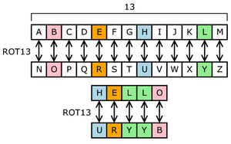
Caesar Cipher
The substitution cipher is a basic cryptographic technique that involves replacing each letter in the plaintext with another letter according to a predetermined substitution rule or key.

Slide 2
Imported Libraries
Flask (Modules: Flask, request, render_template)
Base64
Hashlib

Slide 3
Encryption Key
Key Variable
Base_64

Slide 4
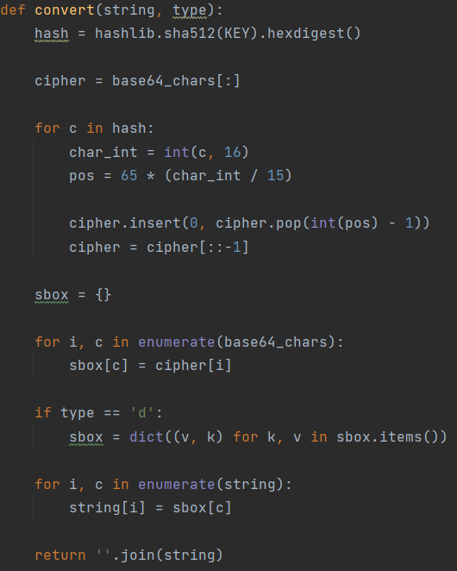
Convert Function
Two Parameters: String and Type
e for Encryption and d for Decryption
Hash algorithm: SHA-512

Slide 5
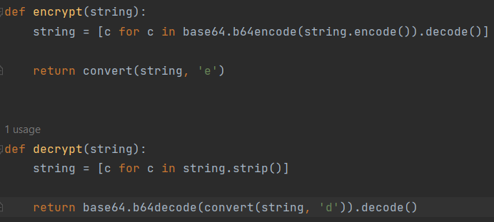
Encryption/Decryption Function

Slide 6
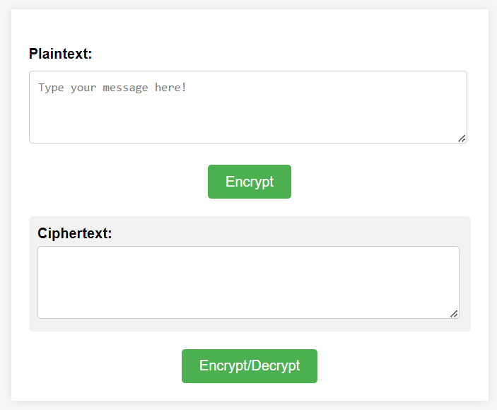
Front-End

Slide 7
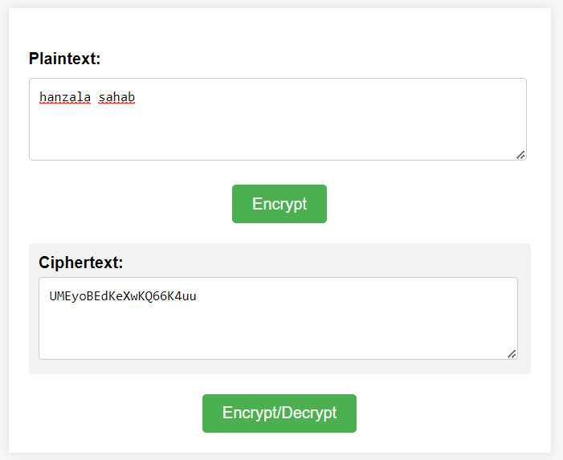
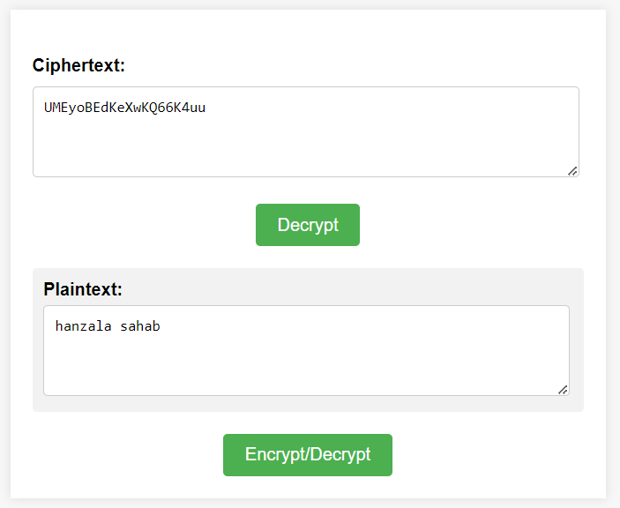
Working Encrypt/Decrypt

